Slide 2
Branches of Psychology
Biological- focuses on how biological influences, specially the brain and nervous system, influence the human mind and behavior
Behavioral- devoted to the study of observable behaviors and how learning takes place via conditioning process.

Slide 3
Developmental- the focus of this branch of psychology is centered on the study of development over the entire course of life.
Social- is interested in how people’s thought, behaviors, and emotions are influenced by other people.

Slide 4
Developmental issues
Nature and Nurture- how development is steered by genes and experience
Continuity and Stage- whether development is gradual, continuous process or a series of discrete stages
Stability and Change- whether development is characterized more by stability over time or by change.

Slide 5
The Influence of Heredity
on Development
Heredity defines our nature.
The field of biology that studies heredity is called GENETICS.

Slide 6
I. Concept on Growth and Development
Growth
Maturation
Development

Slide 7
Growth- is the process of development particularly of becoming physically larger.
Development- way that people grow and change as they age.
Maturation- is the physical, intellectual, emotional process of development.
- means the ordinary development of growth and aging.

Slide 8
Question: Maturation should precede certain in types of learning. How is this applied in the classroom?
Follow the interest of students in assigning tasks.
Mrs. Navarro wants to increase the abilities of her students to solve more concepts should be taught from simple to complex
Consider age level of students in teaching certain concepts
Give the same task to all students in a particular grade level.

Slide 9
II. Principles of Development

Slide 10
Principles of Human Growth and Development
Development is continuous
Development is gradual
Development is sequential
Rate of Development varies Person to person
Development proceeds from general to specific
Most traits are correlated in development

Slide 11
7. Growth and development is a product of both heredity and environment
8. Development is predictable
9. Development
10. There is a constant interaction between all factors of development

Slide 12
Question: In terms of their emotional behavior, babies respond to strange and unusual objects with a general fear. Later, their fears become more specific and more characterized by different types of behavior. Which of the following principles is illustrated by this situation?
A. Development follows a general pattern
B. Development follows an orderly fashion.
C. Development proceeds from general to specific responses.
D. Development rate varies person to person.

Slide 13
Question: Wella was wandering why at age 14 she has not menstruated yet while her friend Rina experienced menarche at age 12. which of the following principle is applied in the situation?
Development rates vary
Development is continuous
Developmental pattern
Development is predictable

Slide 14
III. Stages in Life- span Development

Slide 15
Prenatal – ( conception to birth)
Infancy – (birth to 18 months)
Early Childhood- (18 months to 6 years)
Middle Childhood – (6 to 11 years)
Adolescent – (11 to 20 years)
Early Adulthood – (20 to 40 years)
Middle Adulthood – ( 40 to 65 years)
Late adulthood – ( 65 years and older)

Slide 16
IV. Developmental Theories

Slide 17
A. Cognitive development Theory (Jean Piaget)
The 4 Stages of
Cognitive Development
Sensorimotor (birth to 2 years)- uses senses and motor skills, items known by use.
* Object Permanence

Slide 18
2. Preoperational (2 to 7 years)- symbolic thinking, language used; egocentric thinking
* Animism
* Artificialism
* Ego Centrism

Slide 19
3. Concrete operational ( 7 to 11)- logic applied, has objective/ rational interpretations
*Seriation
* Hierarchical Classification
* Reversibility
* Decentration
* Conservation

Slide 20
4. Formal operational ( 12 and up)- thinks abstractly, hypothetical ideas
* Deductive reasoning-
* Abstract thinking-
* Making and Testing hypothesis
* Metacognition-
* Judgment-

Slide 21
Question: A fourth-grade teacher takes his students on a field trip to a nature center where they learn about plants and animals that live in riparian areas. The following week, he notices that his students are able to answer questions that require them to recall information from their field trip experience. However, they struggle to answer questions that require them to think abstractly about it. Which developmental stage describes these students, according to Piaget?
Formal operational B. Sensorimotor
C. Concrete operational D. Pre-operational

Slide 22
Question: A teacher shows students two glasses: one short and wide, and one tall and thin. Then, using a measuring cup, the teacher pours the same amount of water into both glasses. Most of these students, who were shown the same demonstration three years before, previously thought the tall glass contained more water. Now that they are three years older, nearly everyone in the class agrees the two glasses hold the same amount of water. Which developmental stage describes these students, based on Piaget’s development theory?
A. Formal operational B. Pre-operational
C. Concrete operational D. Sensorimotor

Slide 23
Question: A child is sitting at a table with three friends, and they all have juice in identical, tall cups. The child observes, “ all of our juice is the same!”. The child’s cup is cracked, so the teacher pours that juice into a new cup that is short and round. The child gets angry and yells at the friends that they have more juice in their cups. Which stage is this child demonstrating, according to Piaget?
Sensorimotor B. Preoperational
C. Concrete operational D. Formal operational

Slide 24
B. Moral Development Theory ( L Kohlberg)
Levels and Stages
of
Moral development
Pre conventional- values in external events
> Obedience vs. Punishment – acting to avoid punishment
> individualism vs. Exchange- acting to further one’s own self interest.

Slide 25
2. Conventional- performing right roles
> Good boy, good girl orientation- meeting the expectations of others.
> Law and order- upholding laws to meet societal expectation

Slide 26
3. Post conventional- shared standards, rights, duties and principle
> Social contract- personal values to achieve social conscious
> Universal, Ethical principle- self selection of universal moral principles

Slide 27
Question: Ana comes to school on time because it is one of school’s rules and regulations. Besides, she does not like to disrupt their class by coming late. Which level of Kohlberg’s morally does Ana belong?
Universal
Conventional
Pre conventional
Post conventional

Slide 28
Question: While Grace was cleaning the room she found a wallet near the teacher’s table. Grace decided to give the wallet to the teacher. In Kohlberg’s theory, what stage did she exemplify?
Law and order orientation
Social contract
Good boy-nice girl
Universal Ethical principle

Slide 29
Question: A twelfth –grade student asks a ninth- grade student in her English class to write a persuasive essay for her. The younger student says, “ No, that’s against school policy.” Which orientation of moral reasoning does the ninth-grade student exhibit, according to Kohlberg’s theory of moral development?
Pre-conventional
Post conventional
Unconventional
Conventional

Slide 30
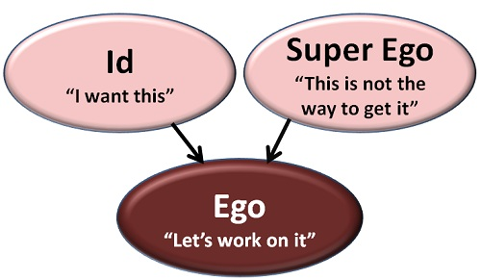
C. Psychoanalytical ( Sigmund Freud)

Slide 31
Question: According to Freud, what is the function of the “ego”
To boost a person’s self confidence.
To push for the fulfilment of one’s self-interest
To mediate between impulsive drives and moral conscience.
To represent instinctive desires and impulses

Slide 32
Question: What is the role of the “super ego”?
To represent instinctive desires and impulses
To inflate a person’s ego and provide a self confidence boost.
To reveal a person’s repressed desires
To provide a conscience and awareness of others through feelings such as guilt.

Slide 33
Question:What did Freud consider to be the role of the “id”?
To be aware of the needs and feelings of those around us.
To moderate our impulses, acting as the moral conscience of the mind
To represent innate, instinctive desires and impulses
To mediate between impulsive drives and moral conscience.

Slide 34
Psychosexual (Freud)
Stages of Psychosexual Theory
Oral (birth to 18 mons.)– infant achieves gratification through oral activities such as feeding, thumb sucking and babbling
erogenous zone: mouth
Fixation
Oral receptive- preoccupied with eating/drinking
Oral aggressive- hostile and verbally abusive to others

Slide 35
Anal ( 18 m0ns. To 3 yrs.) - the child learns to respond to some of the demands of society ( such as bowel and bladder control)
erogenous zone: anus
Fixation
Anal retentive- obsessively organized, or excessively neat
Anal expulsive- reckless, careless, defiant, disorganized

Slide 36
3. Phallic ( 3 to 6 yrs.)- the child learn to realize the differences between males and females and becomes aware of sexuality.
> Oedipus complex- male children sexually desire their mothers- possessive love
> Electra complex- female children sexually desire their father

Slide 37
4. Latency (6 to 12 yrs.)- the child continues his or her development but sexual urges are relatively quiet.
5. Genital ( 13 onwards)- the growing adolescent shakes off old dependencies and learns to deal maturely with the opposite sex.

Slide 38
Question: According to Freud, someone who compulsively bites their nails might have experienced which of the following as a young child?
An overly restrictive breastfeeding schedule
Forced toilet training at a developmentally inappropriate age
Poor bonding between mother and child
Unstimulating activities during key phases of development

Slide 39
Question: Around this age the child begins to toilet train which brings about the child’s fascination in the erogenous zone of the anus.
Latency stage
Genital stage
Anal stage
Phallic stage

Slide 40
Question: Teacher Joy noticed that one of her students is fund of biting the tip of the ballpen. Which theory will best explain her student’s behavior?
Freud’s Psychosexual Theory
Piaget’s Cognitive Theory
Pavlov’s Classsical Conditioning
Skinner’s Operant Conditioning

Slide 41
Question: Latency stage is considered as the “calm” stage of psychosexual development. Which explains this condition?
Children have less energy on this stage
Children are not interested about their sex organs
the libido is blocked temporarily
Sexual energy is diverted to school and peer activities

Slide 42
Question: Which will probably happen if a child failed to resolve the crisis of the anal stage?
The child may become sexually promiscuous
The child may have problems with trust
The child may become obsessed with cleanliness
The child may become smoker

Slide 43
Question: Mark, who is 5- year old, is fund playing with his penis when he urinates. In which stage of Freud’s theory can Mark be considered?
Phallic
Genital
Anal
Latency

Slide 44
Question: A fixation in oral stage of development manifested by an obsession with stimulating the mouth.
Mouth fixation
Oral fixation
Anal fixation
Anal expulsive

Slide 45
Question: Psychosexual development that occurs between the ages of 3 and 6. the source of pleasure at this stage is the genitals.
Phallic stage
Genital stage
Latency stage
Anal stage

Slide 46
Question: Described as the final stage of human psychosexual development. According to Freud’s theories, this stage begins at puberty and constitutes mature adult sexuality.
Anal stage
Latency stage
Genital stage
Phallic stage

Slide 47
Question: According to Freud, the unconscious love and sexual desire of male children for their mother is called:
Psychosexual theory
Electra complex
Oedipal complex
Pleasure principle

Slide 48
Question: Which stage of Freud’s psychosexual theory involves repressing sexual urges and devoting the time to other activities?
Phallic stage
Latency stage
Genital stage
Oral stage

Slide 49
Question: Term used to describe his theory of child development during the first 21 months of life, in which an infant’s pleasure centers are in the mouth.
Oral stage
Phallic stage
Anal stage
Genital stage

Slide 50
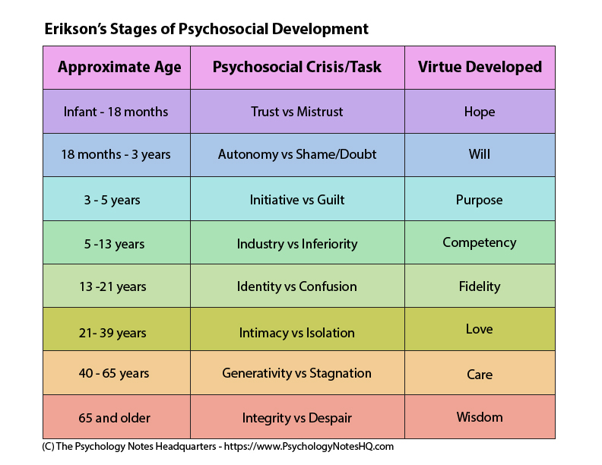
D. Psychosocial ( Erik Erickson)

Slide 51
Question: Which of the following is Erickson’s stage for middle adulthood ?
Generativity vs. stagnation
Intimacy vs. isolation
Autonomy vs. shame
Integrity vs. despair

Slide 52
Question: Which theory discusses a developmental stage when children learn to do things well and are praised for their efforts?
Giligan’s theory of psychosocial development
Vygotsky’s theory of cognitive development
Piaget’s theory of cognitive development
Erickson’s theory of psychosocial

Slide 53
E. Ecological System ( Urie Brofenbrenner)
Microsystem- system closest to the person and the one in which they have direct contact.
Mesosystem- interactions between the different parts of a person’s microsystem
Exosystem- does not involve the person as an active participant, but still affects them.
Macrosystem- actual culture of an individual
Chronosystem- includes the transitions and shifts in one’s lifespan.

Slide 54
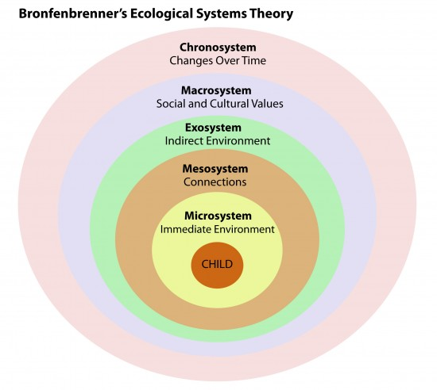

Slide 55
Question: Environmental system that includes the student’s family, peers, teacher, and neighborhood?
Exosystem
Macrosystem
Mesosystem
Microsystem

Slide 56
Question: theory that focuses on social contexts in which students live and the people who influence their development within five environmental systems?
Psychoanalytic
Psychosexual
Moral development
Brofenbrenner’s Ecological Theory

Slide 57
Question: Exosystem
Environmental system that links microsystem
Environmental system that involves the broader culture in which students and teachers live.
Environmental system that involves experiences in another setting that influences what students and teachers experience
Theory that focuses on social contexts in which students live and the people who influence their development within five environmental systems?

Slide 58
Question:Mesosystem
A. Environmental system that refers to sociohistorical conditions of students’ development
B. Environmental system that links microsystem
C. Environmental system that involves the broader culture in which students and teachers live.
D. Theory that focuses on social contexts in which students live and the people who influence their development within five environmental systems.

Slide 59
Question:Macrosystem
A. Environmental system that involves experiences in another setting that influences what students and teachers experience.
B. Environmental system that links microsystem
C. Environmental system that involves the broader culture in which students and teachers live.
D. Theory that focuses on social contexts in which students live and the people who influence their development within five environmental systems.

Slide 60
f. Emotional Quotient (Daniel Goleman)
Be aware and be in control of the emotions of oneself and others.
2 aspects of EQ
1. understanding oneself.
2. understanding others and their feelings.

Slide 61
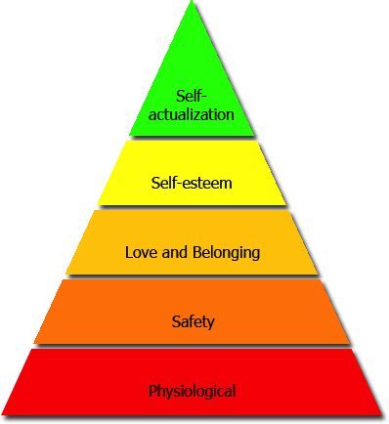
h. Hierarchy of Needs ( Abraham Maslow)

Slide 62
g. LAD ( Noam Chomsky)
- is a hypothetical module of the human mind posited to account for children’ s innate predisposition for language acquisition.
- the LAD concept is an instinctive mental capacity which enables an infant to acquire and produce language.

Slide 63
i. Parenting Styles (Diana Baumrind)
Dimensions of parenting behavior
Demanding- refers to the extend parents control their children’s behavior or demand their maturity.
Responsiveness- refers to the degree parents are accepting and sensitive to their children’s emotional and developmental needs.

Slide 64
Question: What parenting styles when parents impose rules and expect obedience?
Permissive
Authoritarian
Authoritative
Neglecful

Slide 65
Question: Parents submit to their child’s desires. They make few demands and use little punishment. In which parenting styles does this item fall?
Authoritarian
Neglectful
Permissive
Authoritative

Slide 66
V. Special Education

Slide 67
a. ADHD
difficulty sustaining attention
struggling to follow instruction
difficulty with organization
difficulty waiting or taking turns
talking excessively
Losing things necessary for tasks or activities
interrupting or intruding upon others

Slide 68
b. Learning Disabilities
Dyslexia- a language and reading disability
Dyscalculia- problems with arithmetic and math concepts
Dysgraphia- a writing disorder resulting in illegibility

Slide 69
c. Autism Spectrum Disorder
- is a developmental disorder that affects communication and behavior.
People with ASD have;
Difficulty with communication and interaction with other people
Restricted interests and repetitive behaviors
Symptoms that hurt the person’s ability to function properly in school, work, and other areas of life

Slide 70
d. Intellectual Disability
Is a disability characterized by significant limitations both in intellectual functioning ( reasoning, learning, problem solving) and in adaptive behavior, which covers a range of everyday social and practical skills.
This disability originates before the age of 18.

Slide 71
e. Down Syndrome ( Trisomy 21)
- is a condition in which a person is born with an extra chromosomes.
- is a genetic disorder that involves birth defects, intellectual disabilities, characteristic facial features.
- it often involves heart defects, visual and hearing impairments, and other health problems.

Slide 72
f. Gifted and Talented Children
- means those persons between the ages of four and twenty-one whose abilities, talents, and potential for accomplishment are so exceptional or developmentally advanced that they require special provisions to meet their educational needs.

Slide 73
Gifted: having extraordinary intellectual ability and creativity.
Specific Academic Aptitude
* reading * writing
* math * science
* social studies * world languages
Talented: having exceptional skills and ability in a specific area.
* arts * Musical Abilities *dance
*Leadership abilities
* Creative or Productive thinking

Slide 74
g. Placement
- refers to the amount of time in each school day that a student spends in the resource or in a general education classroom.
Inclusion- is about recognizing and respecting the differences among all learners and building on the similarities
Mainstream- is about getting learners to ‘fit into’ a particular kind of system or integrating them into this existing system.

Slide 75
Question: Which of the following criteria can be used to define intellectual disabities?
Significantly below average intellectual functioning
Impairments in adaptive functioning generally
These deficits should be manifest before the age of 18 years
All of the above

Slide 76
Question: Down’s syndrome is a ___________ disorder.
Chromosomal
Sex-linked
Incomplete dominance
Single- gene

Slide 77
Question: In learning disabilities, the name for mathematical disorder is:
Dyspraxia
Dyslexia
Dyscalculia
Dysgraphia

Slide 78
Question: Which of the following is an example of an intellectual disability?
Dyslexia
ADHD
Mental Retardation
Autistic Spectrum Disorders

Slide 79
Question: Which of the following is an example of a Specific Learning Diisability?
Mental Retardation
Dyslexia
ADHD
Autistic spectrum disorders

Slide 80
1. A branch of Psychology that studies how people grow and change throughout the course of their lives is _______________.
a. Social psychology
b. Biological Psychology
c. Developmental Psychology
d. Behavioral Psychology

Slide 81
2. A developmental issue concerned with whether an individual is a product of his/her genes or of his/her culture
A. Prenatal and postnatal C. Continuity and stage
B. Nature and nurture D. Stability and change

Slide 82
3.The process by which certain potentials are inherited from the parents for his development is called _________________.
Heredity
Life
Character
Birth

Slide 83
4. The conflicts faced by an individual at every stage of psychological development are called
Equilibrium C. Crises
Changes D. Confusion

Slide 84
5. In which way does heredity affect the development of the learner?
By providing equal potential to all
By placing limits beyond which the learner cannot develop
By compensating for what environment fails to develop
By making acquired traits hereditary

Slide 85
6. This is the transition period between childhood to adulthood where rapid physical changes and sexual maturity occur resulting in changes in ways of feeling, thinking, and acting.
Early adulthood
Puberty
Middle adulthood
Adolescence

Slide 86
7. It refers to an individual’s bodily change in size and structure
Maturation C. Growth
Learning D. Development

Slide 87
8. Which of the following situations best illustrates the concept of growth?
A high school student gets a score of 85 in mental ability test.
An education student has gained knowledge on approaches and strategies in teaching different subjects.
A elementary grader has learned to play the piano.
A high school students’ height increased from 5’2’’ to 5’4’’

Slide 88
9. Developmental changes due to aging is called _______________
Maturation C. Growth
Learning D. Development

Slide 89
10. What concept can best describe Rey’s ability to walk without a support at the age of 12 months because of the “internal ripening” that occurred in his muscles, bones, and nervous system development?
Development C. Maturation
Learning D. Growth

Slide 90
11. Any change in the behavior of an individual is called _____________.
Development C. Maturation
Learning D. Growth

Slide 91
12. It is the brain’s ability to change from experience:
Learning C. Tabula rasa
Growth D. Plasticity

Slide 92
13. The degradation of synapses and dying off of neurons that are not strengthened by experience
Retardation C. Forgetting
Pruning D. Aging

Slide 93
14. Studies in the area of neurosciences disclosed that the human brain has limitless capacity. What does this imply?
Pupils can possibly reach a point where they have learned everything.
Every child is a potential genius.
Some pupils are admittedly not capable of learning
Every pupil has his own native ability and his learning is limited to this native ability

Slide 94
15. Train a child the way he should be so that when he grows, he will not depart from it. Which of the following principles supports this?
Early development is less critical than later development.
Development is determined by the environment.
Early development is more critical than later development.
Development is determined by his heredity.

Slide 95
16. A newborn baby can move her whole body at one time instead of moving a part of it. Which of the following principles is illustrated by his behavior?
Development follows a general pattern.
Development proceeds from general to specific.
Development follows an orderly pattern.
Development proceeds from specific to general.

Slide 96
17. Which principle is NOT TRUE?
Development is a function of nature and nurture
Development occurs at different rates
Development occurs in a predictable manner
Development occurs in an unpredictable manner

Slide 97
18. One research-based principle of child development is that “Early experiences have strong effects on children’s development and learning”. What is an implication of this to teaching-learning?
Enrich early childhood with favorable experiences.
Assist their development by bringing them to tutorial centers.
Enroll them in preschool.
Teach them academic lessons early.

Slide 98
19. Which of the following condition most likely brings about a classroom climate that is business-like yet non-threatening?
The authoritarian teacher is in full control of the classroom.
Students leaders list the names of noisy classmates.
Rules, limits, and expectations are made clear during the first day of classes.
The teacher assigns student leaders who will check class attendance.

Slide 99
20. To build strong and healthy relationship in class, which should be out of the picture?
Criticizing
Befriending
Blaming
Listening
I and II C. II and III
I and IV D. I and III

Slide 100
21. Which teaching practice gives primary consideration to individual differences?
Preparing two different sets of examination, one for the fast learners and another for the slow learners.
Allowing children to show that they learned the stages of mitosis in away where they feel most comfortable except by lecturing.
Allowing children to show that they learned the stages of mitosis in a way where they feel most comfortable.
Applying two sets of different standards.

Slide 101
22. Lito, twelve-years old who is in grade six comes from a dysfunctional family and has been abused and neglected. He has been to orphanages and three different elementary schools. He can decode at the second grade level, but he can comprehend orally materials at the fourth or fifth grade level. The most probable cause(s) of this student’s reading problem is/are:
Immaturity C. Neurological factors
Emotional factors D. Poor teaching

Slide 102
23. Which statement on student diversity is CORRECT?
Teacher must do his/her best to reduce student diversity in class.
The less the diversity of students in class, the better for teachers and students.
Student diversity is purely due to students’ varied cultures.
Teacher should accept the value diversity.

Slide 103
24. Which student thinking/behavior indicates that he/she values diversity?
He/She emphasizes on the differences among people and disregards their commonalities.
He/She regards his culture as inferior to other’s cultures.
He/She regards his culture as superior to other’s cultures.
He/She accepts the fact that all people are unique in their own way.

Slide 104
25. The term for the developing organism from 2 weeks to 8 weeks of conception
Zygote C. Embryo
Fetus D. Chromosomes

Slide 105
26. Sequence the steps of zygote becoming an embryo.
Life support of the cell develop for the embryo
Cell differentiation intensify
Layers develop into organ systems
Organs appear
I, III, II and IV B. IV, III, I and II
C. II, I, IV and III D. I, II, III and IV

Slide 106
27. Medical science favored pregnant women talking or singing to their fetus is a part of __________.
Natal synchrony learning
Prenatal learning
Midnatal learning
Postnatal learning

Slide 107
28. It is advisable to promote manipulative materials to a child in his early childhood to develop:
Numerical skills
Social skills
Reading readiness skills
Pre-handwriting skills

Slide 108
29. Which characteristic behavior of a Grade IV pupil makes you conclude he is behind in his development in comparison with the average Grade IV pupil?
Has not achieved emotional independence from parents
Has not learned to get along with his age mates
Has not achieved socially responsible behavior
Has not achieved a feminine and masculine social role

Slide 109
30. Why is early childhood regarded as teachable stage for the teaching of skills?
Children at this stage are attracted to games
Children at this stage are growing fast
Children at this stage are excited with whatever they undertake
Children at this stage are adventurous

Slide 110
31. Study shows that this is NOT among the appropriate practices of cognitive development among preschoolers?
One year old develop creative interest
Three year old speak as often as possible
Four year old say nursery rhymes
Five year old add drama to reading situations

Slide 111
32. The role of play in the preschool and early childhood years is that is .
Develops the upper and lower limbs
Increases imagination due to expanding knowledge and emotional range
Develops competitive spirit
Separates reality from fantasy

Slide 112
33. Laughing at a two-year old child who uttered a bad word is not a proper thing to do because in this stage of the child’s life, the child is ____________.
Socializing
Considering the views of other
Distinguishing right from wrong
Distinguishing sex differences

Slide 113
34. How can we optimize learning for pre-school children?
Employ technology
Make learning fun
Construct well-furnished classrooms
Use visual media always

Slide 114
35. A pre-school teacher is thinking about how to better develop her pupils’ fine-motor skills. Which of the following should the teacher consider?
Encourage children to act independently
Conduct a variety of fun and enjoyable activities
Provide daily coloring book activities
Ask the children to do repeated writing drill activity every day

Slide 115
36. This stage of development is known as the questioning age or exploratory because the child is constantly asking so many questions.
Babyhood C. Early childhood
Infancy D. Late childhood

Slide 116
37. During the first day of school, crying children are a common sight especially in the pre-school department. What explains this?
Object permanence
Stranger shyness
Separation anxiety
Temper tantrums

Slide 117
38. What development task best displays adolescence 13 to 18 years?
Learning social modesty
Achieving masculine and feminine roles
C. Assuming civic responsibility
D. Learning to get along well with agemates

Slide 118
39. An adolescent exhibits what common characteristics?
Reasonable and secure
Feels intense emotions and sense of disequilibrium
Slow but steady physical growth
Passive and obedient

Slide 119
40. In the formal operational stage, which is/are adolescents capable of doing to solve a problem?
Formulate hypothesis
Systematically test hypothesis
Reason out
II only C. I and II
III only D. I, II, and III

Slide 120
41. Based on Kohlberg’s theory, what is the level of moral development shown when children generally do what is right in order to come up with their parents’ and teacher’s expectations of a good child?
Pre-conventional C. Post-conventional
Conventional D. Formal

Slide 121
42. When a child says that the sun is sleeping at night, the child is in the pre-operational stage, particularly _____________.
Centration C. Animism
Egocentrism D. Reversibility

Slide 122
43. In Piaget’s stages of cognitive development, which is the tendency of the child to only see his point of view and to assume that everyone has the same point of view?
A. Reversibility
B. Egocentrism
C. Symbolic function
D. Centration

Slide 123
44. Which is the most basic in Maslow’s hierarchy of needs?
A. Socialization
B. Actualization
C. Self-esteem
D. Altruism

Slide 124
45. Who asserted that children must be given the opportunity to explore and work on different materials so that they will develop the sense of initiative instead of guilt?
A. Kohlberg
B. Erickson
C. Maslow
D. Gardner

Slide 125
46. The Freudian stages when the child isn’t aware of or concern with sexual impulses, instead he is more interested in developing friendship with other children of the same sex.
Anal C. Latency
Phallic D. Genital

Slide 126
47. For Sigmund Freud, which is the deciding agent of human personality by which we reason out and consider the best response to situations?
A. Id
B. Superego
C. Ego
D. Unconscious

Slide 127
48. What explains the tendency of preschool children to focus on one aspect of an object while excluding other aspects?
A. Centration
B. Translation
C. Intuition
D. Ego-centration

Slide 128
49. To what does Piaget’s cognitive development theory that the ability to determine that a certain quantity will remain the same shape despite adjustment of the container shape or apparent size refer?
Conversion C. Conservation
Accommodation D. Assimilation

Slide 129
50. Of Piaget’s Cognitive Concepts, which refer to the process of fitting a new experience to a previously created cognitive structure or schema?
A. Assimilation
B. Schema
C. Accommodation
D. Equilibrium

Slide 130
51. What is Daniel Goleman’s term for interpersonal effectiveness?
PR index
XY theory
Superior IQ
Emotional quotient (EQ)

Slide 131
52. A person who cannot form a healthy intimate relationship with other people developed a problem in his childhood particularly in which stage, according to Erik Erikson?
Identity vs Role confusion
Basic trust vs mistrust
Intimacy vs isolation
Autonomy vs shame and doubt

Slide 132
53. Bing, a preschooler, insists on getting noodles for himself from the serving dish each time his family attends a gathering, even though he usually drops pasta on the floor. When his mother tries to assist him, he brushes his mother off and insists on doing it by himself. In the context of Erickson’s psychosocial development theory, what stage of psychosocial development best describes Bing’s behavior?
Trust vs. Mistrust B. Industry vs. Inferiority
Initiative vs. Guilt D. Autonomy vs. Shame & Doubt

Slide 133
54. What is the pattern of change which can affect child’s development such as in parents going abroad for work?
A. Microsystem
B. Mesosystem
C. Macrosystem
D. Chronosystem

Slide 134
55. Which does Noam Chomsky assert about language learning for children?
Young children learn and apply grammatical rules and vocabulary as they are exposed to them.
Begin formal teaching and grammatical rules to children as early as possible.
Do not require initial formal language teaching for children.
II only C. I and II
I only D. I and III

Slide 135
56. Studies on delinquent students recommend which effective parenting style for adolescents?
Authoritarian C. Authoritative
Neglectful D. Laizzes faire

Slide 136
57. What field of education manages children with behavioral problems like attention-deficit disorders?
A. Distance education
B. Special education
C. Skills and technology training
D. Early childhood education

Slide 137
58. A student with Attention Deficit Disorder exhibits
Care for his/her personal things
Impatient while waiting for his/her turn during games
Completes work before shifting to another
Excessively quiet

Slide 138
59. Which characterize autistic children?
Repetitive behaviors
Difficulty in social interactions
Showing more interest in objects than on people
I and II
I and III
II and III
I, II, and III

Slide 139
60. On categories of exceptionality in the young, what is difficulty in focusing and maintaining attention, and/or recurrent hyperactive and impulsive behavior?
A. ADHD
B. Emotional/conduct disorders
Autism
Speech and communication disorders

